Slide 1
HR Analysis Dashboard
Analysis of human resource metrics using Power BI.

Slide 2

Introduction
Human Resource Analysis is the process of collecting, analyzing, and interpreting data related to an organization’s workforce to improve decision-making and optimize human resource practices. It combines data analysis techniques with HR functions to provide insights into employee performance,

Slide 3
Power Bi :
Power BI is a business intelligence tool developed by Microsoft that helps you visualize data, create interactive reports, and gain insights from various data sources. It allows users to turn raw data into meaningful dashboards and reports with ease — even without coding knowledge!
DAX:
DAX (Data Analysis Expressions) is a formula language used in Power BI, Excel Power Pivot, and Analysis Services to perform data calculations and create custom measures in reports. It’s similar to Excel formulas but designed specifically for data modeling and analysis in Power BI.
Charts:
a chart is a visual representation of data that helps you analyze trends, patterns, and comparisons in a clear and interactive way. Charts are a part of visuals in Power BI reports and dashboards.

Slide 4
Slicer:
A Slicer in Power BI (and Excel) is a visual tool that lets you filter data quickly and interactively in your reports and dashboards. It acts like a dynamic filter, allowing users to select values and instantly see how those selections affect other visualizations on the report.!
Data Source
The Data I collect from the Kaggle in csv file

Slide 5
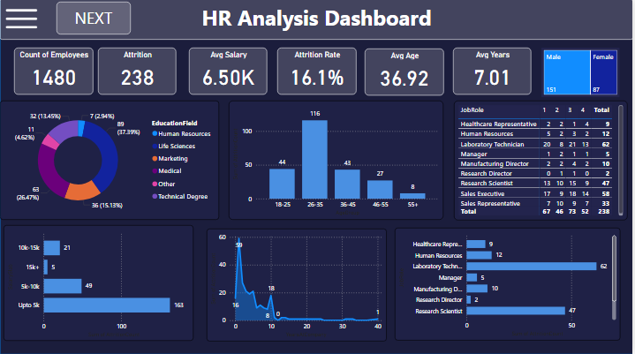
.

Slide 6
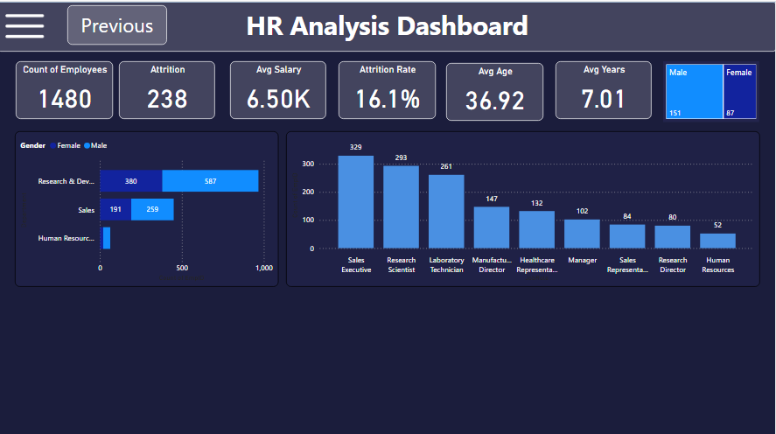
.

Slide 7
Pie Chart: Education Field Distribution
Represents the distribution of employees across different education fields like Human Resources, Life Sciences, Marketing, Medical, Other, and Technical Degree.
Why use it? A pie chart makes it easy to compare proportions at a glance and identify the dominant education fields in the organization.
Bar Chart: Age Distribution
Shows the number of employees across different age groups (18-25, 26-35, 36-45, 46-55, 55+).
Why use it? It highlights age group concentrations, helping in understanding workforce age diversity.

Slide 8
Bar Chart: Salary Range Distribution
Compares the number of employees in different salary ranges (Up to 5k, 5k-10k, 10k-15k, 15k+).
Why use it? Useful for understanding the overall salary structure and identifying the most common pay brackets.
Line Graph: Attrition by Years of Service
Plots employee attrition against years of service.
Why use it? Identifies when employees are most likely to leave, helping to create targeted retention strategies.

Slide 9
Horizontal Bar Chart: Job Role vs Attrition
Compares the number of employees leaving from each job role.
Why use it? Highlights high-turnover roles, helping HR to address job-specific retention issues.
Stacked Bar Chart: Gender Distribution by Department
Shows the gender split across departments (Research & Development, Sales, Human Resources).
Why use it? Provides insights into gender diversity within each department, helping track diversity and inclusion goals.

Slide 10
Vertical Bar Chart: Job Roles Distribution
Displays the count of employees per job role.
Why use it? Identifies the most common job roles, helping in workforce planning and talent acquisition.

Slide 11

Conclusions
The overall attrition rate is 16.1%, with early-career employees (0–10 years of service) and those in lower salary brackets facing the highest attrition.
Age group 26–35 and departments like R&D and Sales see the most attrition, highlighting the need for targeted retention strategies.
Disparities in attrition across job roles, education fields, and gender point to potential areas for improved employee engagement and support.

Slide 12
Recommendations
Improve retention strategies for young employees.
Provide competitive salary packages.
Focus on employee engagement in high-attrition roles.
Recommendations are drawn directly from the findings, aiming to address primary attrition drivers and create a more engaging and rewarding work environment.

Slide 13
Thank you!
Do you have any questions?

